Slide 1
HPCC++: Enhanced High Precision Congestion Control
draft-miao-ccwg-hpcc
draft-miao-ccwg-hpcc-info
Rui Miao, Surendra Anubolu, Rong Pan, Jeongkeun Lee, Barak Gafni, Jeff Tantsura, Allister Alemania, Yuval Shpigelman
IETF-120 CCWG
Jul 2024

Slide 2

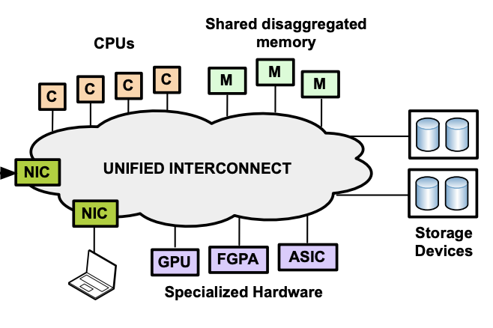
Cloud desires hyper-speed networking
bigger data to compute & store
Today, clouds have
faster compute & storage devices
more types of compute and storage resources
High-performance storage
High-performance computation
Resource disaggregation
Storage-compute separation is norm
HDD→SSD→NVMe
Higher-throughput, lower latency
1M IOPS / 50~100us
Distributed deep learning, HPC
CPU→GPU, FPGA, ASIC
Faster compute, lower latency
E.g. latency <10us
More network load
Need ultra-lower latency: 3-5us, > 40Gbps (Gao Et.al. OSDI’16)
Notes:
[title], because the network -> the performance bottleneck in many systems in the cloud
New applications such as high-perf storage and large-scale distributed deep-learning, use new hardware that can generate and process data orders of magnitude faster than before, and allow very low access latency, so network is much more important than before.
Moreover, resource disaggregation is happening in the cloud, which disaggregate compute and memory into separate pools. So even memory accesses will go through the network, which adds considerable load to the network, and requires ultra-low latency. As a result, network is becoming bottleneck.
[]
Title of high per compute

Slide 3


HPCC++: Enhanced High Precision Congestion Control
New networking ASICs have in-band telemetry capabilities
Packets collect telemetry on their route
Can we use in-band telemetry as precise feedback for congestion control?
pkt
pkt
pkt
Telemetry
Telemetry
Adjust rate
per ACK
Sender
Receiver
Notification pkts/ACKs

Slide 4
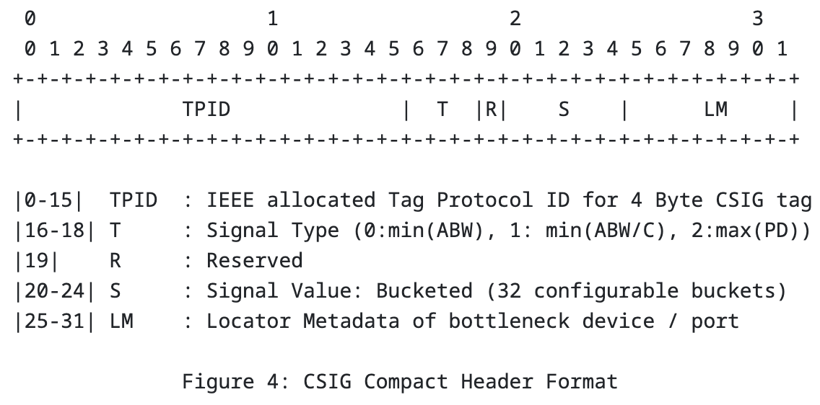
Support CSIG (Congestion SIGnaling)
CSIG is a compact in-band telemetry [I-D.ietf-ravi-ippm-csig]
fixed-size aggregate metric computed over the hop devices
Compact (supported) and expanded (require further defined) formats with Type-Value format
u’ = u1 + u2, where u1 = min(ack.L[i].qlen,L[i].qlen) / (ack.L[i].B*T) u2 = txRate / ack.L[i].B

Slide 5
Support CSIG (Congestion SIGnaling)
Handle path changes
Two consecutive packets are required for the new path
Max(qlen/B) can be interpreted as an `expected` sojourn time for the packet in the tail
max(PD) is an approximate of max(qlen/B)
max(PD) is sojourn time of signal-carrying packet. i.e., packet at the tail
max(qlen/B) is the queue length when the packet is dequeuing.

Slide 6
Your Feedback is Appreciated!

Slide 7
BACK UP

Slide 8



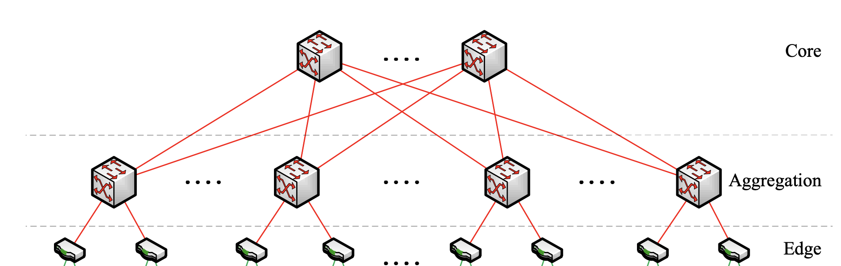
Hyper-speed network chips to form hyper-speed networking
App
App
Hardware-offloading (e.g., RDMA)
Traditional software-based networking stacks cannot keep with the speed
Network Stack
Network Stack
Host
Host
Network Fabric
Real-time Congestion control (CC)
Lots of data and communication => more pressure on the network

Slide 9
HPCC++ provides ideal performance
Using in-band telemetry as the precise feedback
Fast convergence
Sender knows the precise rate to adjust to
Near-zero queue
Feedback does not only rely on queue
Few parameters
Rich and precise feedback, reduces heuristics which requires more parameters
Notes:
All 3 actually share same [read]
CC converges slowly [read]
There are standing queues [read]
Parameter tuning is complex [read]
So we ask, [read]
It turns out, just the right time to ask this question
10:20
[] feedback should not rely on queue

Slide 10
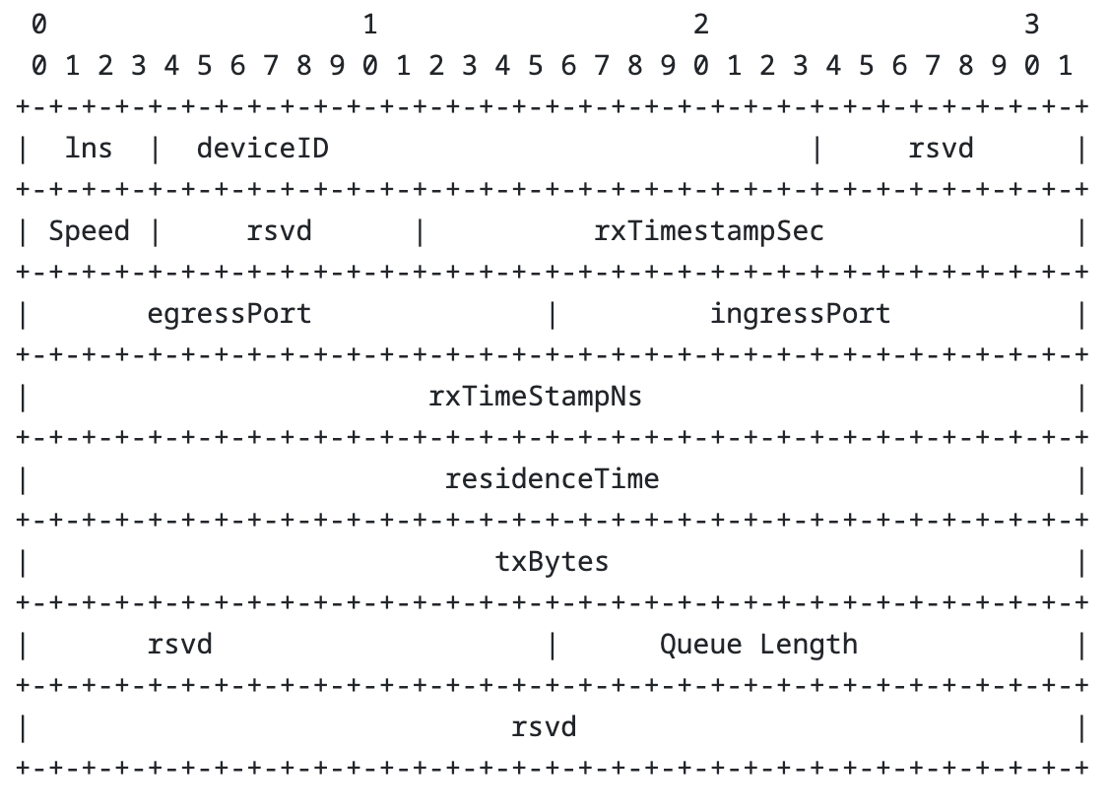
Our proposals
draft-miao-ccwg-hpcc
Defines the algorithm using telemetry information, including queue length, transmitted bytes, timestamp, link capacity, etc.
draft-miao-ccwg-hpcc-info
Provides environment-dependent packet formats of telemetry encodings, including IFA2.0, IOAM, P4.org

Slide 11
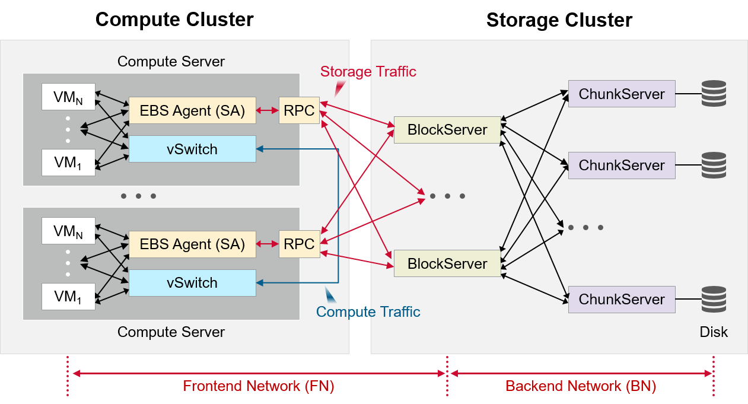
Deployment experience
Deployed widely for storage, AI training, and database applications in one of the major cloud providers
Achieved significant boosts in throughput and latency
Source: https://www.broadcom.com/blog/high-precision-congestion-control

Slide 12
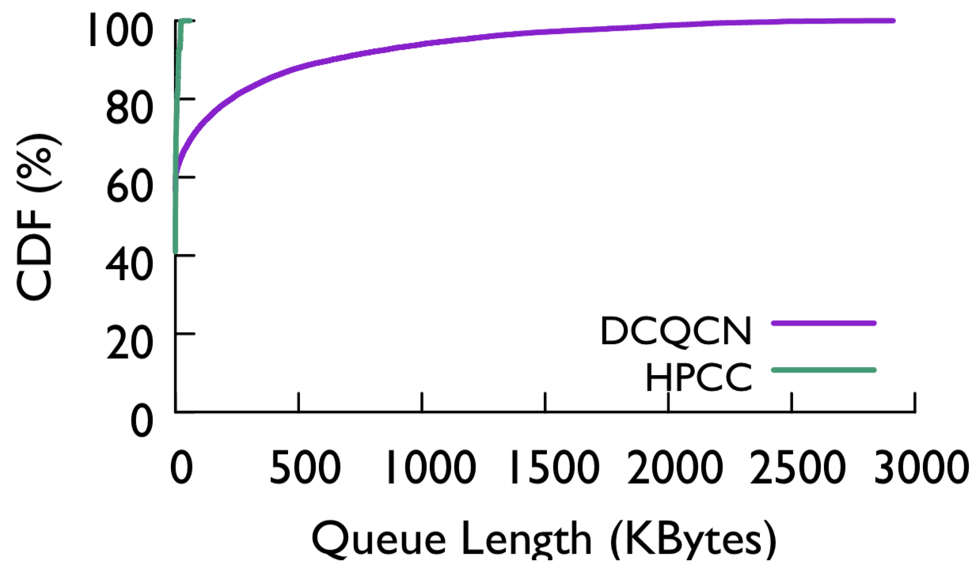
HPCC++ achieves lower FCT and near-zero queue
In testbed, vs. DCQCN (hardware-based, widely used in industry)
Web search traffic at 50% load
Extensive tests compared with other CC in simulation. HPCC performs better
HPCC++
- P99: 23KB (7us queue delay)
95% lower
55% lower
Notes:
In our testbed, we show that HPCC reduces the flow completion time a lot. We compare with DCQCN, which is a hardware-based solution that is widely used in industry, and also widely deployed in Alibaba. HPCC performs better under many diff traffic patterns. For example, with web search traffic at 50% load, HPCC significantly reduces the tail FCT. Note that for long flows, HPCC and DCQCN performs similar; this is because they are less sensitive to queueing delay, and they occupy the bandwidth most of the time.
We also monitor the queue length distribution. HPCC achieves near zero queue. Even at 99pct, the queue length is only 23KB, which is only 7us queueing delay.
We also compare with other CC. They are not available in HW, so we compare in simulation. The result is similar. Refer to paper.
24:48

Slide 13
Thank You

